Slide 1


There’s a nap for that.
Jeremy Chan
Tsz Ho Ho
Calvin Lo
Dominic Kwok
Nathalie Wong

Slide 2
At a glance…
Reason for focusing on sleep
App + server + ML + web interface
Lots of existing sleep apps (accelerometer, sonar)
Novel aspect is tying it to heating and room temp
Non intrusive - wearable

Slide 3
3 glaring problems
Saturated market with high inertia
Severe delay in time-to-market for highly demanded products (2x performance)
High risk of failed technological integration of the acquired company

Slide 4




The State of the Industry | Competitors

Slide 5
The State of the Industry | Competitors
Trailing behind Xilinx
Recommend increasing sales numbers
More advertising

Slide 6
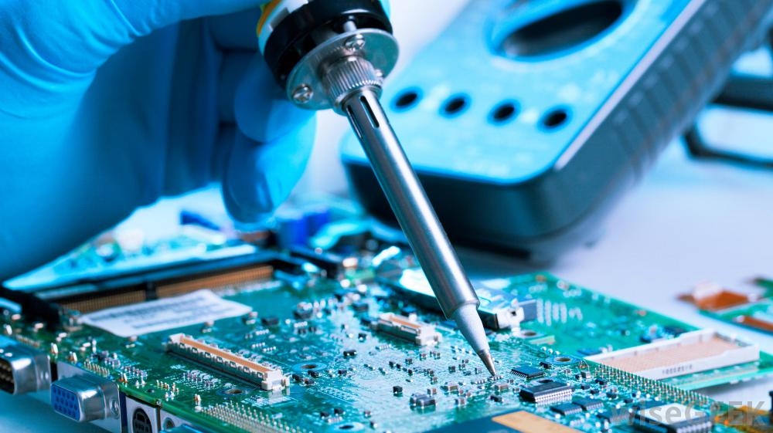
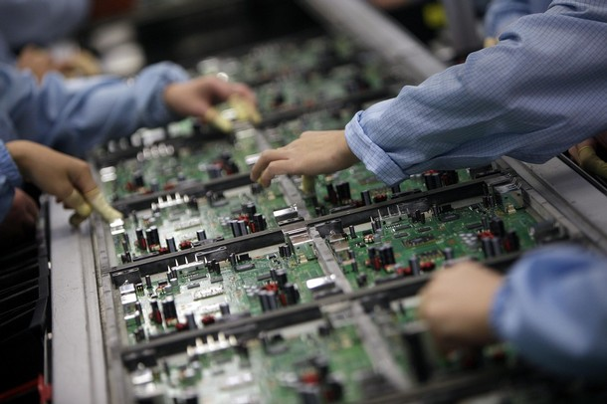


The State of the Industry | New Entrants
Research and Development
New topology
Design tools
Industrial solution
Manufacturing Cost
In house?
Setup cost
Loyalty discount
Customer Loyalty
Partnerships
Switching cost
Human Resources
Institutional cooperation
Entrance threat is minimal

Slide 7
The State of the Industry | Demand
Major Distributors are Arrow Inc and Macnia Inc [1]
Arrow is global leader in electronics distribution (2nd largest [2]), reported revenue at USD 23 billion in 2015 [3]
FPGA market is only valued at USD 3.92 billion in 2014 [4].
Bargaining power of buyers are high
Leverage Intel’s existing infrastructures and distribution channels to achieve more cost effective sales channels

Slide 8
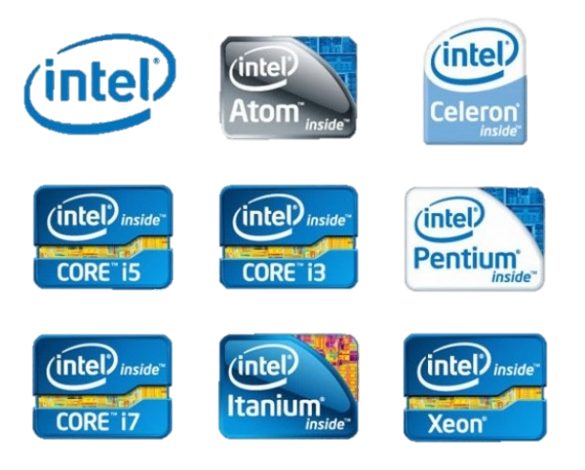
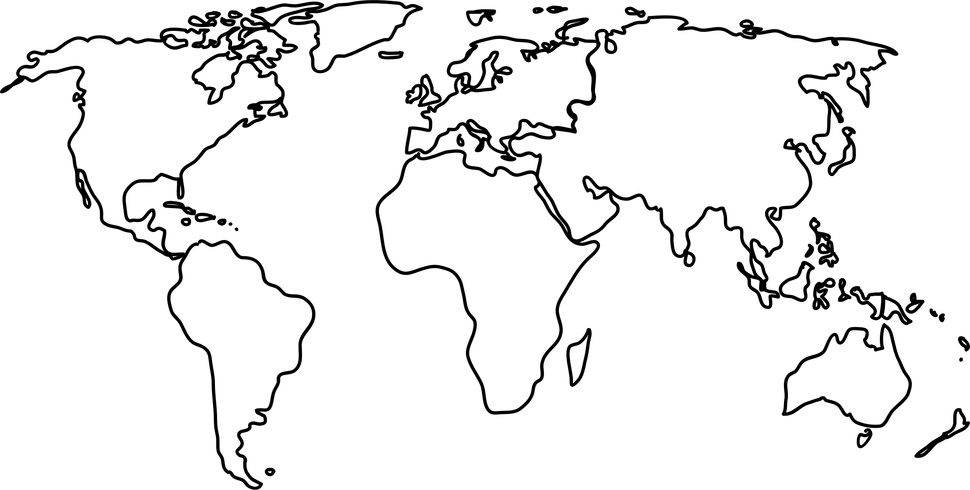
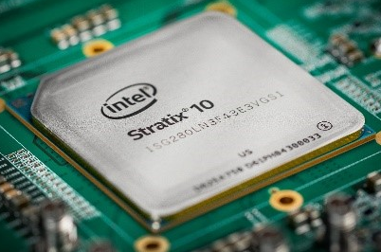
Drivers of Value Creation
Continue branding for FPGAs
Integrate all IP
Take care in differing managerial styles
https://newsroom.intel.com/editorials/intels-stratix-10-fpga-supporting-smart-connected-revolution/
http://mtechsolve.blogspot.co.uk/2015/06/differences-between-dual-core-quad-core.html
http://www.drodd.com/html7/world-map-outline.html

Slide 9


Business Level Strategy
Acquisition of McAfee ($7.7 bn)
Acquisition of Infineon Wireless Solutions ($1.4 bn)
Acquisition of Altera ($16.7 bn)
Sold 51% stake of McAfee ($4.2 bn)
August
January
August
September
2009
2010
2011
2013
2014
2015
2016
2017
Partnership with tech giants
Further acquisitions if integration successful
Broaden partnership with customers
Provide customer specific solutions to broaden the customer base

Slide 10
Our Recommendation
Saturated market with high inertia
Explore new markets (IoT, machine learning, data centre)
Severe delay in time-to-market for highly demanded products (2x performance)
Leverage Intel’s personnel, in-house product capabilities, and distribution
High risk of failed technological integration of the acquired company
Buy Xilinx
Continue to develop independent product lines
Improve communication between management

